Slide 1
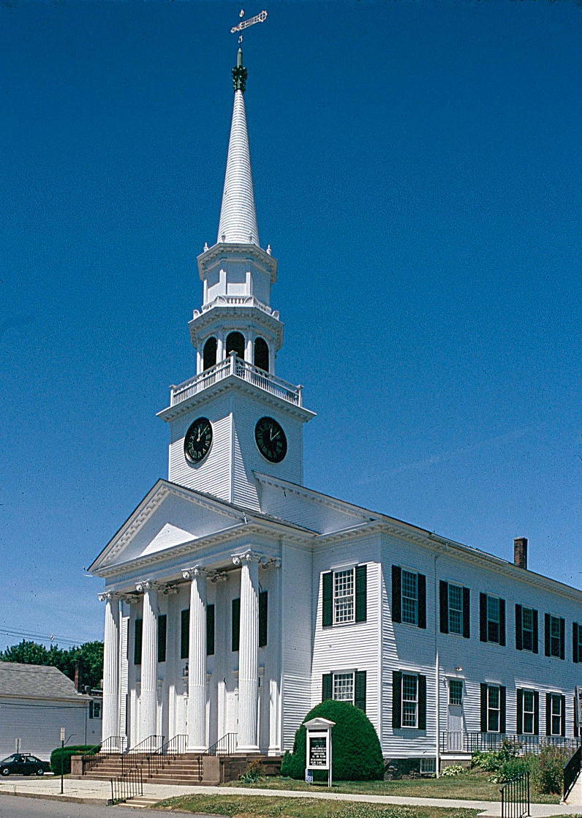
First Congregational Church Annual Meeting 2021
February 7, 2021
Unrestricted

Slide 2
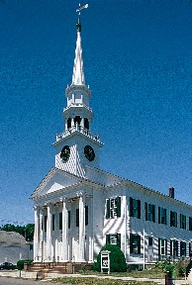
Item 1
Receive and act upon the reports and recommendations of the Boards, Committees, and Organizations of the Church

Slide 3
Item 2
Act upon the proposed 2021 Ministry Budget as submitted by Church Council

Slide 4
Overview of Budget 2021
INCOME
EXPENSE
Pledges $574,039
Ministry Contrib. $ 15,343
Special Events $ 0
Trustee Distrib. $ 32,817
Rent Collected $ 39,550
2021 Surplus $115,223
Other Income $ 97,684
TOTAL INCOME $874,656
Admin Expense $236,990
Bldg & Grounds $181,427
Christian Ed $ 66,983
Clergy $239,329
Music $104,552
Pilgrim Fellow $ 5,500
Outreach $ 30,575
TOTAL EXPENSE $865,356
FUNDING Surplus $ 9,300

Slide 5
Item 3
Receive the report of the Nominating Committee and act upon their recommendations for Officers and Members of Boards and Committees of the Church

Slide 6
Item 4
Change of Title as recommended by the Board of Deacons from
Minister of Faith Formation
to
Associate Minister

Slide 7
Item 5
Approve the Creation Justice Church Covenant

Slide 8
Item 6
Receive and act upon the reports and recommendations of the Ministers

